Slide 1
WEB APPLICATION PROGRAMMING
NAME : Choi jae hun
STUDENT ID : 201911148

Slide 2
>>
Table of contents
1
Project goal
2
code
3
What to add

Slide 3
1
Project goal

Slide 4
>>
Project goal
Part 1
Project goal is
Create a responsive web application to monitor and display real-time air quality data,
including temperature, humidity, PM2.5, PM10, NOx, NH3, CO2, SO2, and VOC levels. The application will utilize HTML, CSS, and JavaScript.

Slide 5
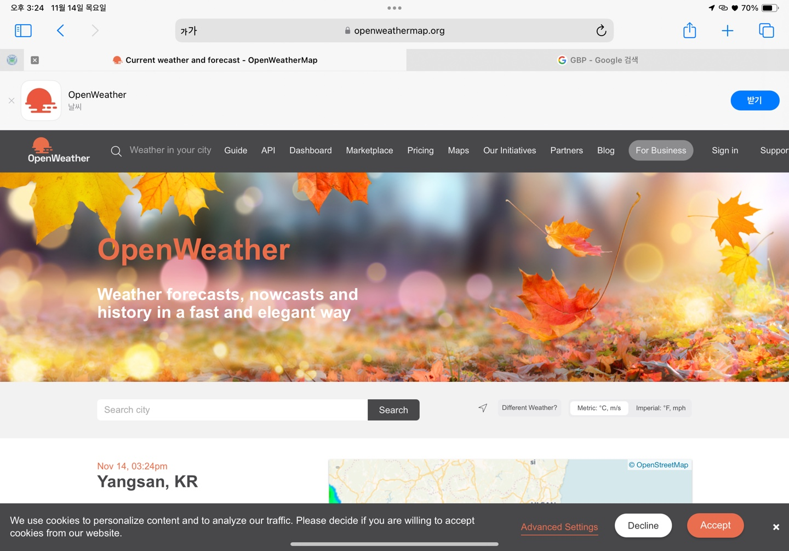
>>
Project goal
Part 1
API

Slide 6
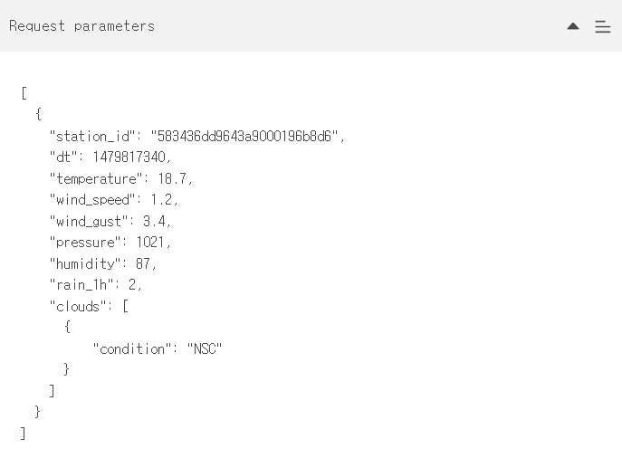
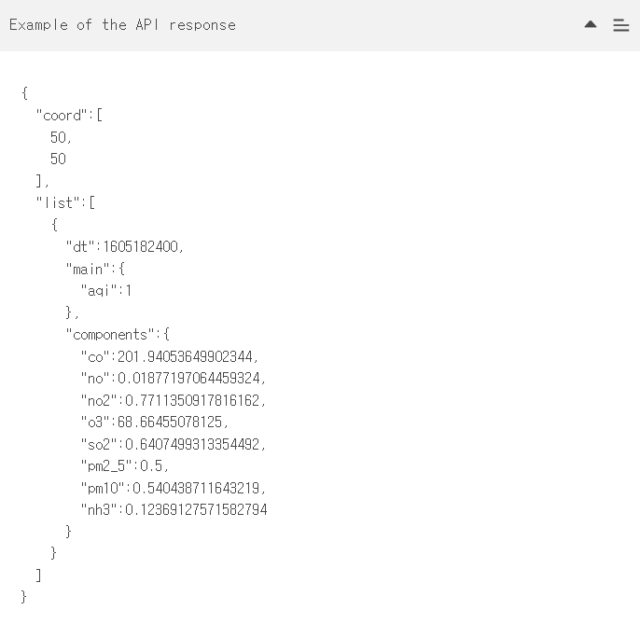
>>
Project goal
Part 1
API

Slide 7
2
code

Slide 8
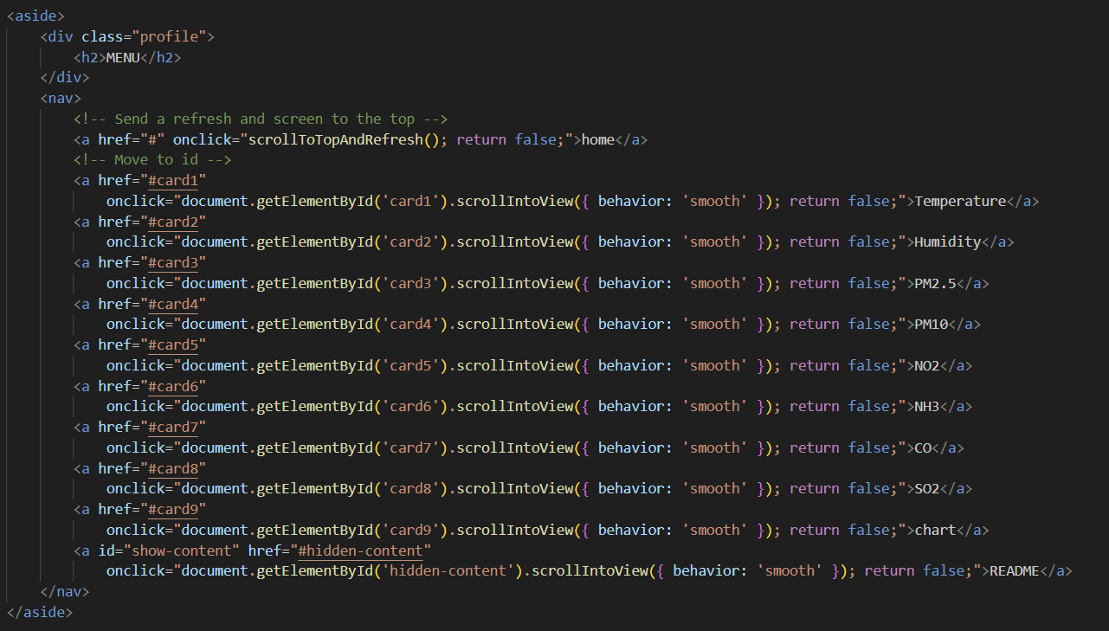
>>
code
Part 2
Aside tag

Slide 9
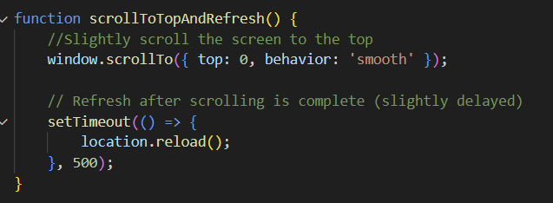
>>
code
Part 2
Aside tag
HTML
JavaScript

Slide 10
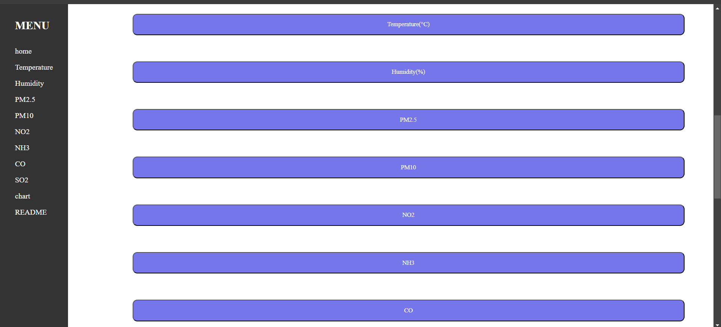
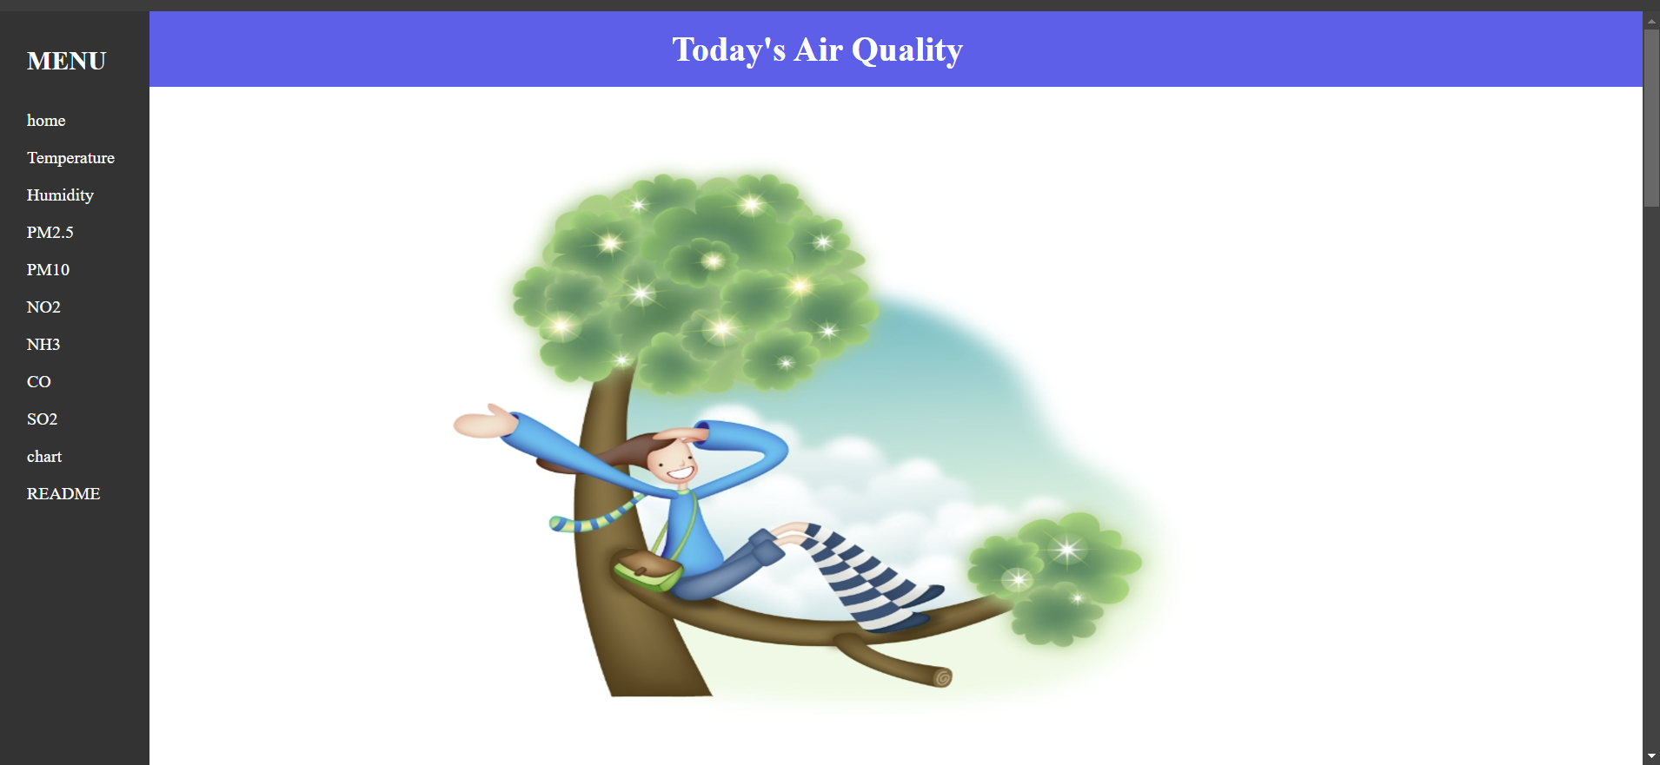
>>
code
Part 2
Aside tag

Slide 11
>>
code
Part 2
Aside tag
HTML

Slide 12
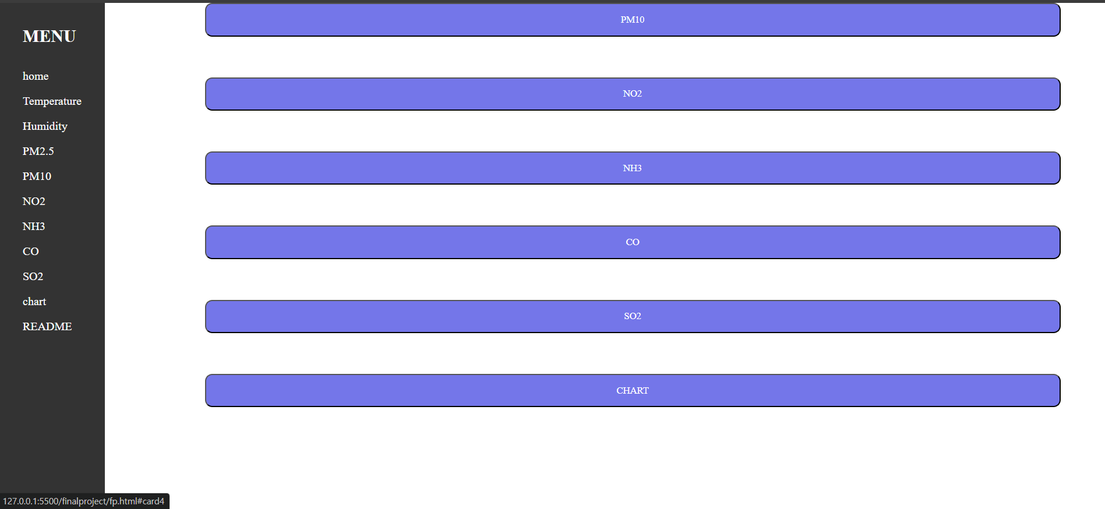
>>
code
Part 2
Aside tag

Slide 13
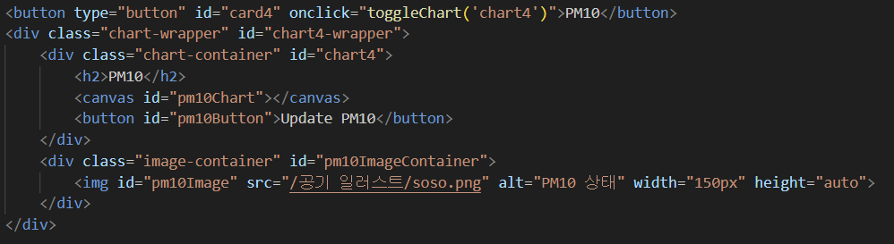
>>
code
Part 2
Main tag
HTML

Slide 14
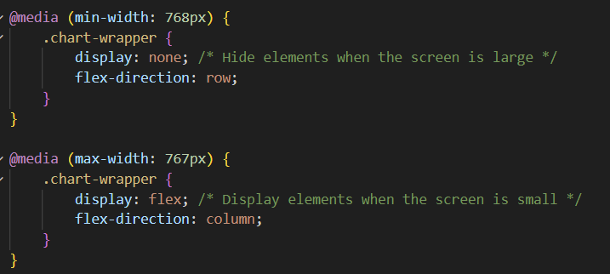
>>
code
Part 2
Main tag
CSS

Slide 15
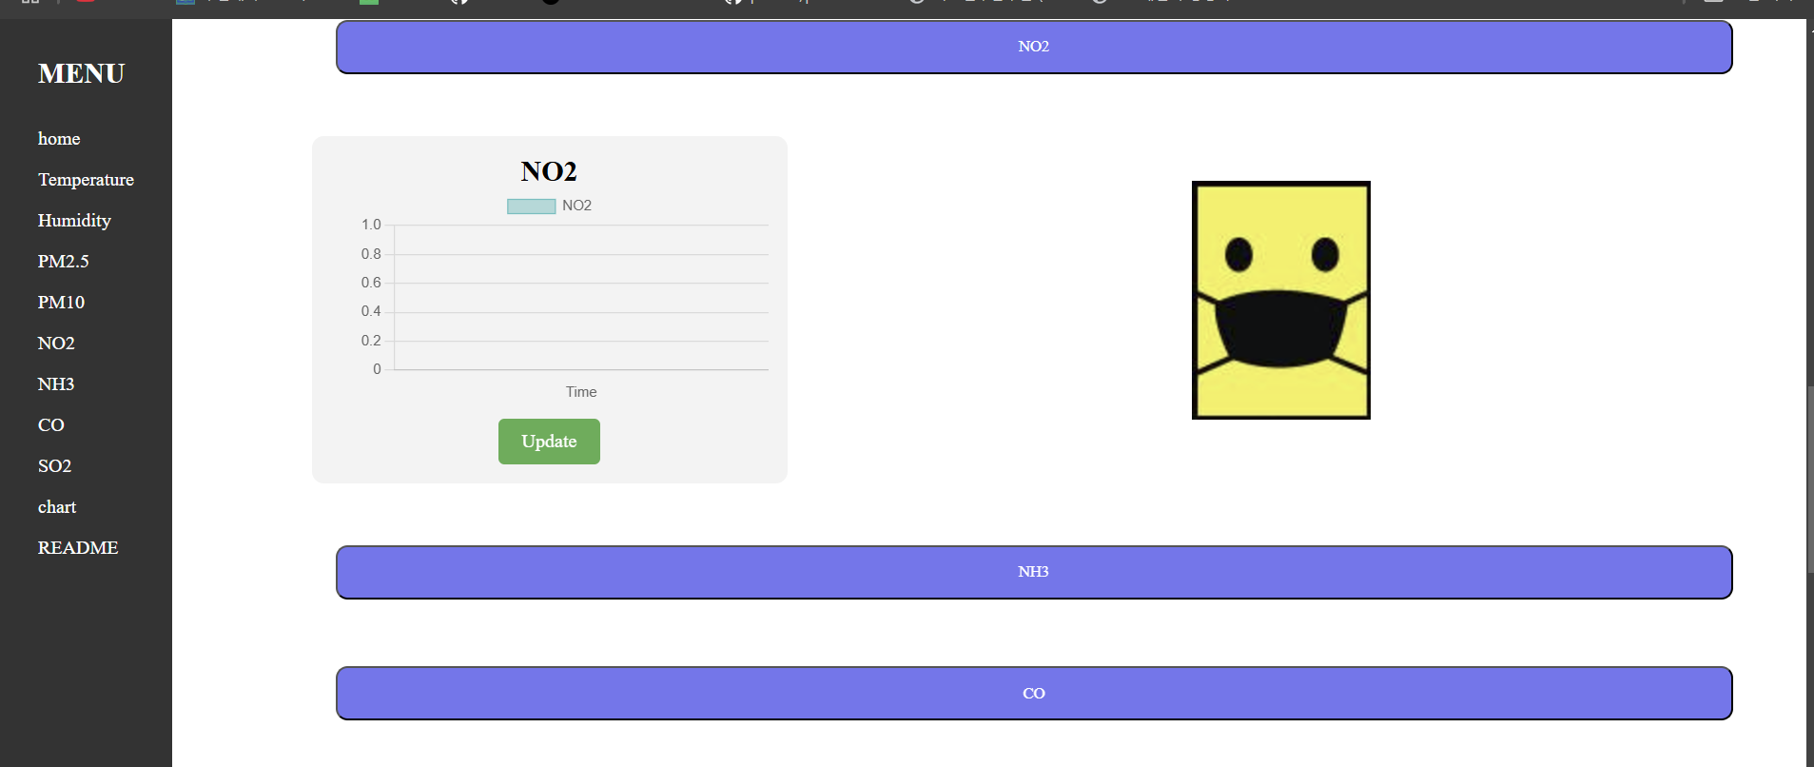
>>
code
Part 2
Main tag

Slide 16
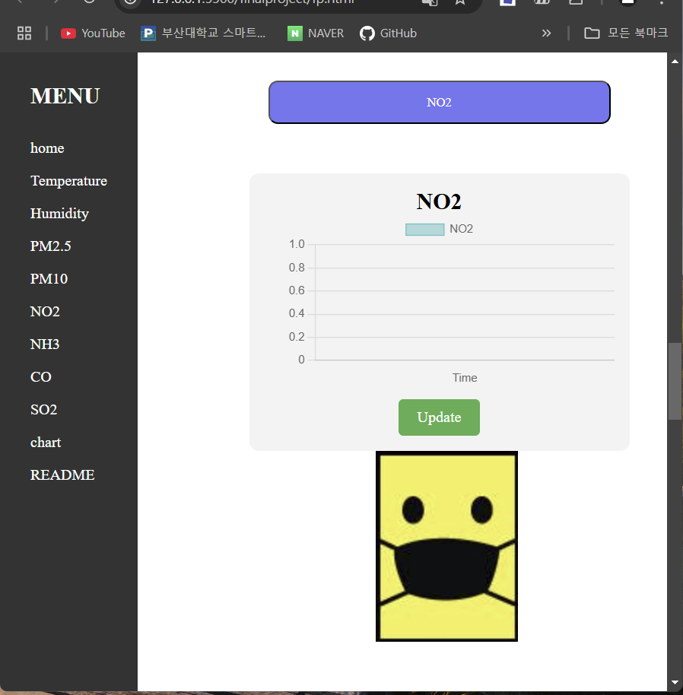
>>
code
Part 2
Main tag

Slide 17
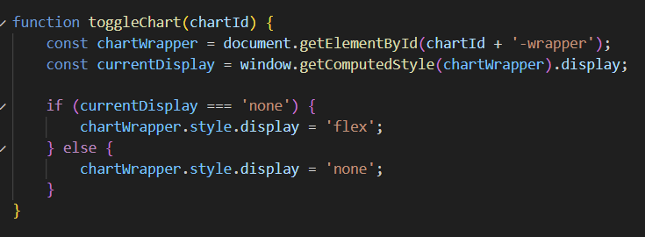
>>
code
Part 2
Main tag
JavaScript

Slide 18
>>
code
Part 2
Main tag

Slide 19
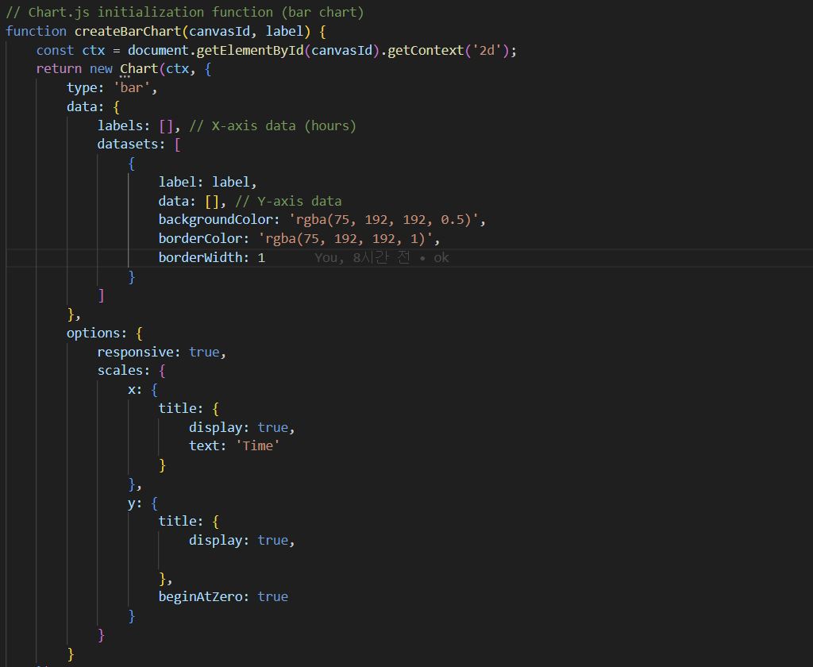
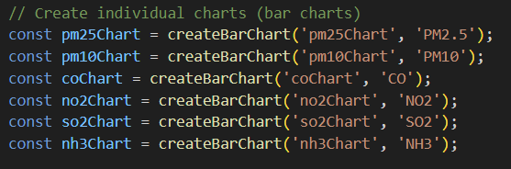
>>
code
Part 2
Main tag
JavaScript

Slide 20
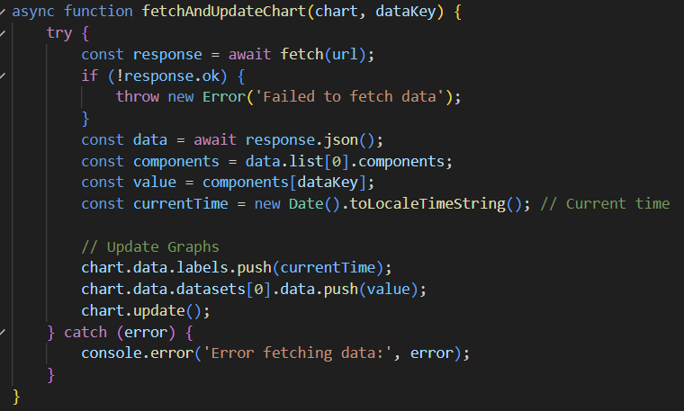
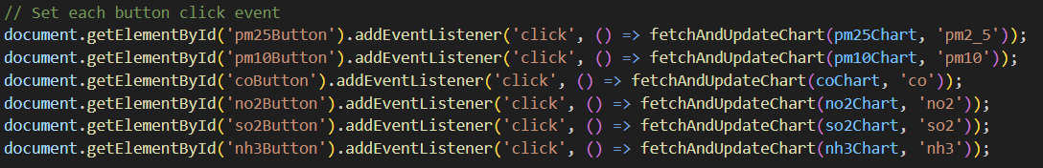
>>
code
Part 2
Main tag
JavaScript

Slide 21
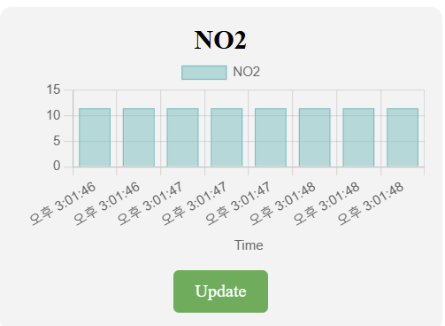
>>
code
Part 2
Main tag

Slide 22
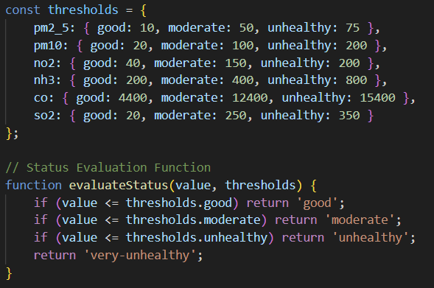
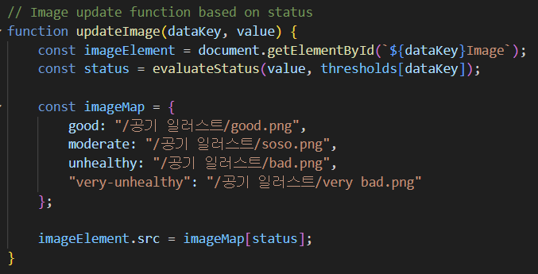
>>
code
Part 2
Main tag
JavaScript

Slide 23
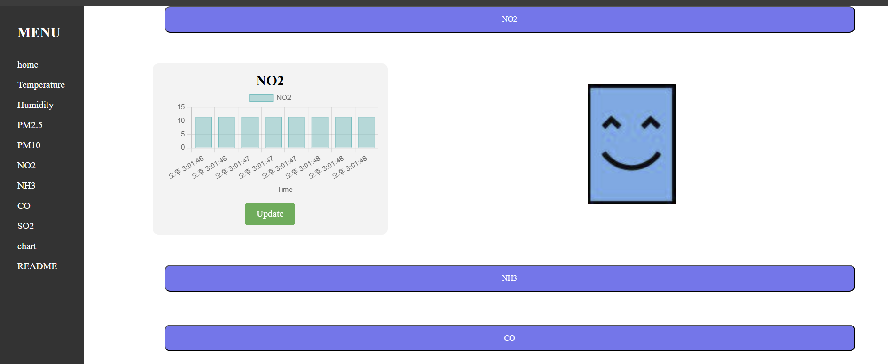
>>
code
Part 2
Main tag

Slide 24
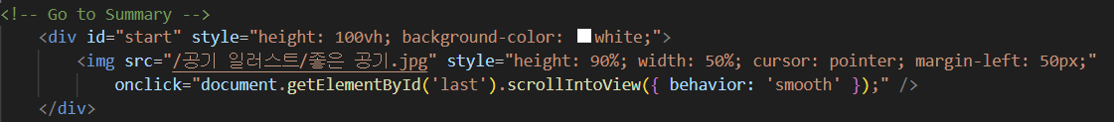
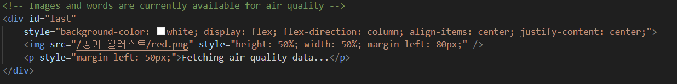
>>
code
Part 2
Main tag
HTML

Slide 25
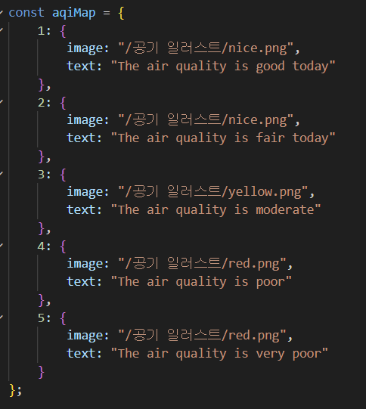
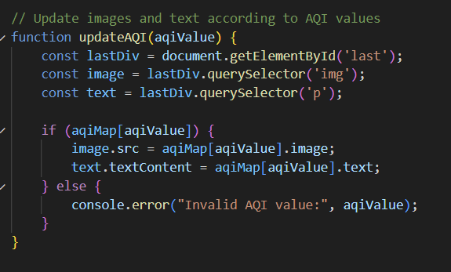
>>
code
Part 2
Main tag
JavaScript

Slide 26
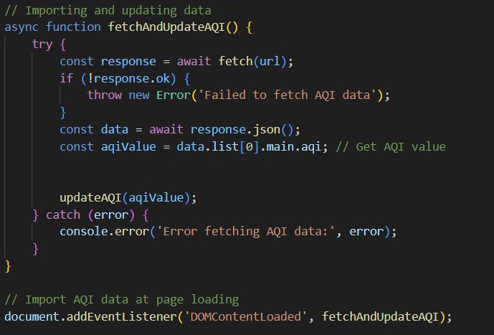
>>
code
Part 2
Main tag
JavaScript

Slide 27
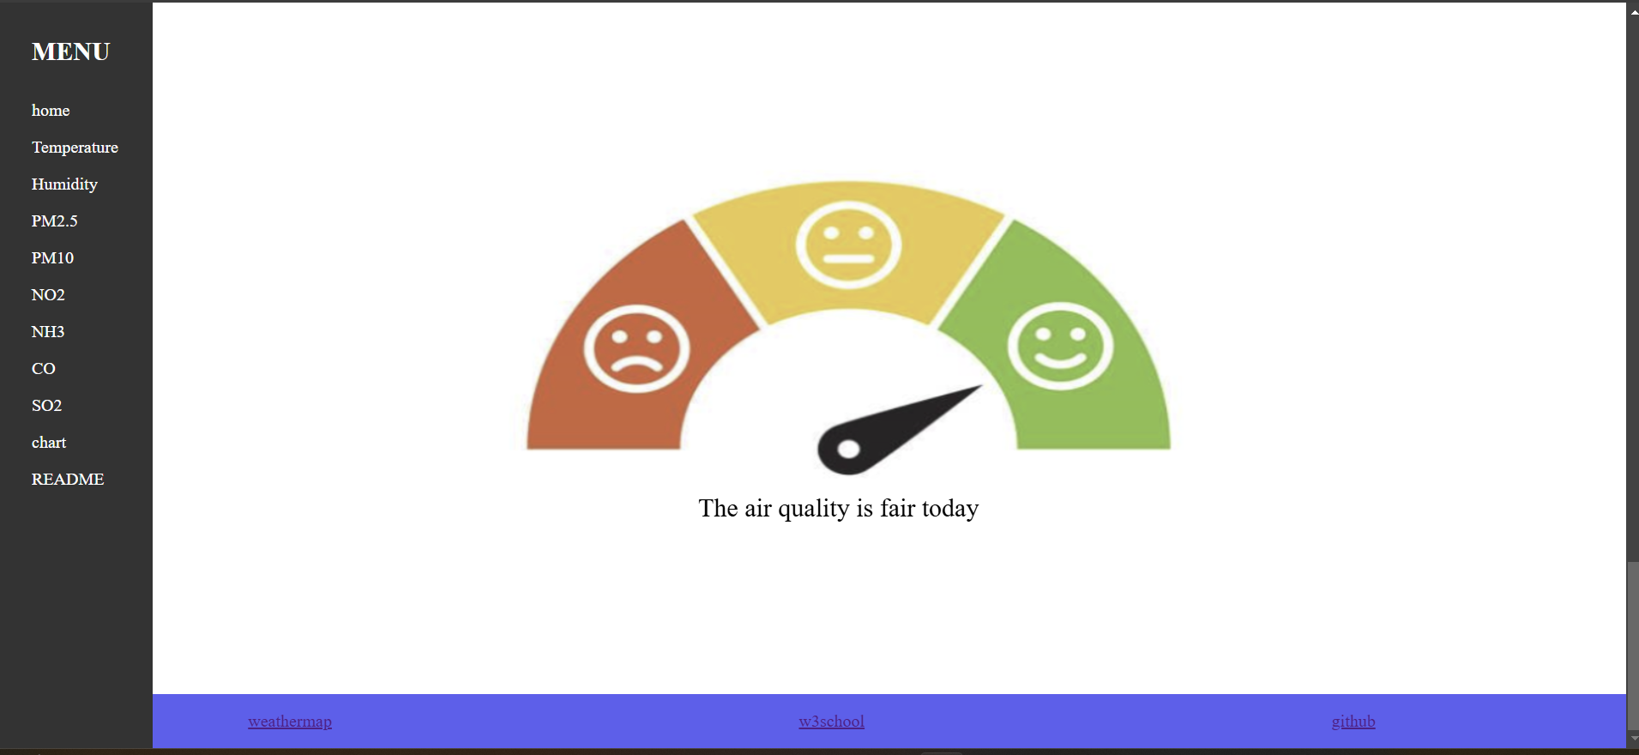
>>
code
Part 2
Main tag

Slide 28
3
What to add

Slide 29
>>
What to add
Part 3
1
I want to add a graph that shows the changes in air pollutant levels throughout the day at 4-hour intervals.
2
I want the graph to display the values directly on each data point.
3
I aim to enhance the overall design of the graph to make it more visually appealing.

Slide 30
THANK YOU

